Slide 1
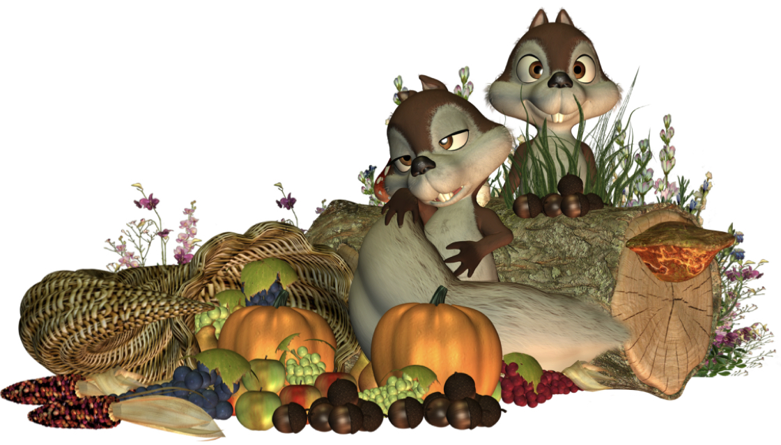
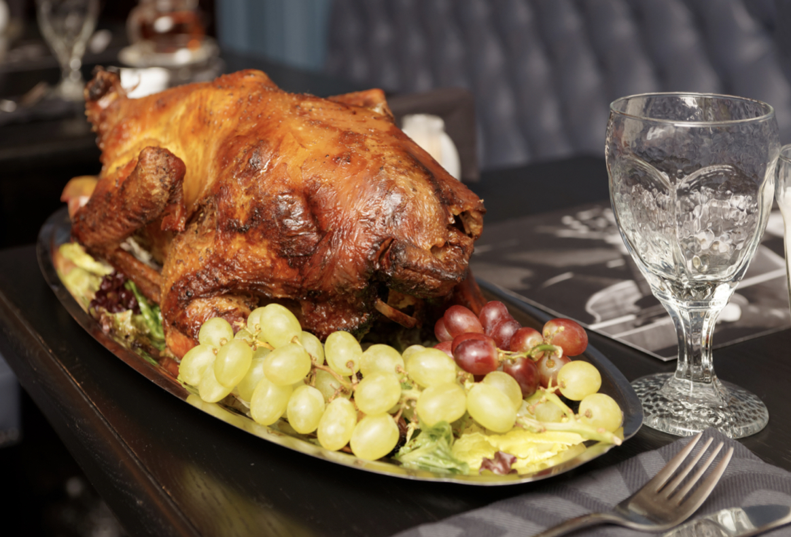
Happy Autumn from Eternal Gems
What we believe
What is heaven? A place where everyone loves everyone, there is no jealousy, death, or despair
How do I get to Heaven? Believe that God, the creator of the world, sent his son to die for us. Jesus died to pay for all the bad things we have done, and all we have to do is ask to be forgiven!
How do I ask God to forgive me? “Dear God, I am sorry for all the people I have hurt. I pray that you would forgive me, and help me to stop hurting others.
Celebrate All Saints Day with us
Philippians 4:6-7Do not be anxious about anything, but in every situation, by prayer and petition, with thanksgiving, present your requests to God. And the peace of God, which transcends all understanding, will guard your hearts and your minds in Christ Jesus.
Psalm 107:21-22Let them give thanks to the Lord for his unfailing love and his wonderful deeds for mankind. Let them sacrifice thank offerings and tell of his works with songs of joy.
Psalm 118:1Give thanks to the Lord, for he is good; his love endures forever.
Did you know?
Eternal Gems has a Youtube Channel
(Which focuses on skills that can help young people achieve their dreams of entrepreneurship)
Subscribe to our newsletter Here
We’re hiring! if you want to gain experience and make a positive difference, go here

